Slide 1
K-12 Routes-to-Market: Overcoming the Sales and Channel Challenge
Rob Underwood
TTM Advisors

Slide 2
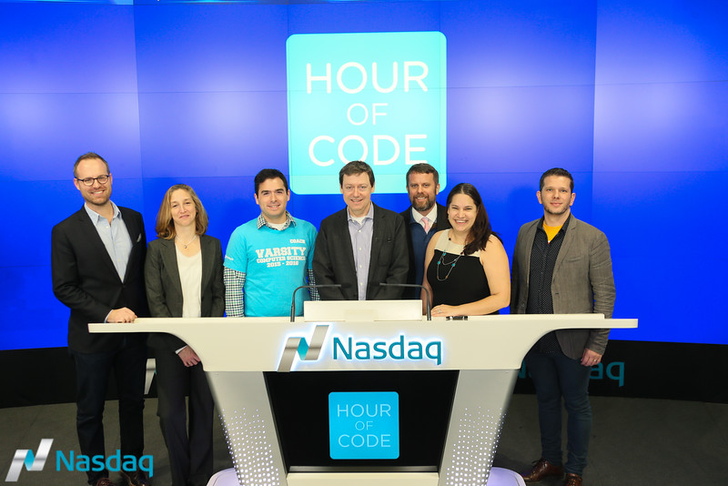
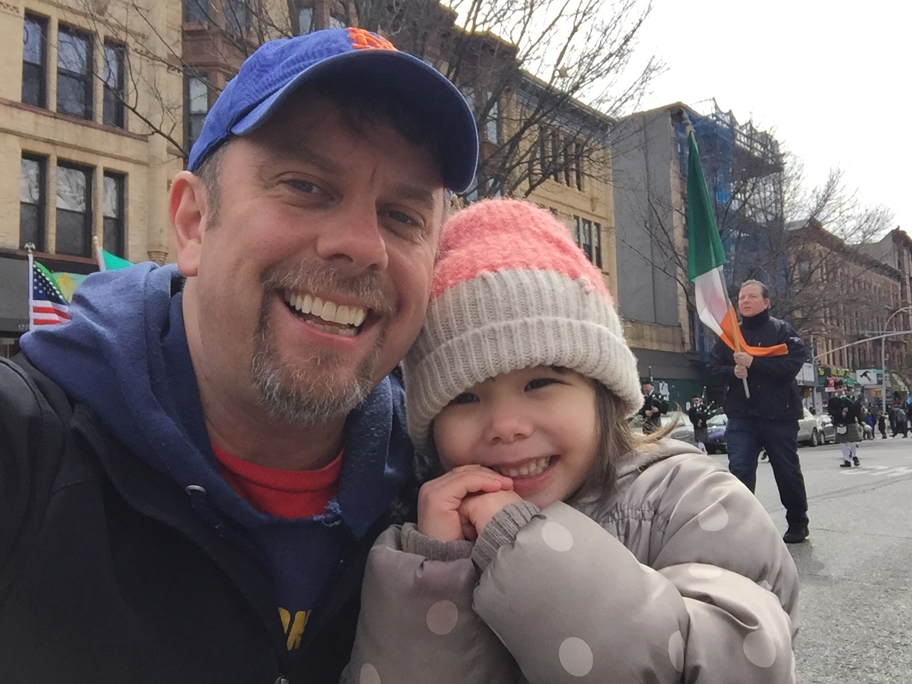

About Me (Rob)
Started career in technology including stint in Silicon Valley at Pandesic (an early SaaS company) in Web 1.0 days
12+ years in management consulting. 2000-2006 at KPMG/BearingPoint. 2006-2013 in Deloitte’s corporate strategy practice where I focused on sales, customer, and channel strategy, primarily for tech companies
CTO of Relay Graduate School of Education from 2013-2015
Now at TTM Advisors where I serve education and edtech organizations, both for-profit (i.e., VC backed) and non-profit
Active in CSForAll efforts both nationally and in the city. Founding ED of TeachCS; Co-founder of CodeBrooklyn with Brooklyn Borough President Eric Adams; Lead Volunteer for NY Tech Responds

Slide 3
Questions
This deck and my speaker notes are at https://github.com/ttm-advisors/selling_to_K12_edu
What are the sales channel options? What are my alternatives?
Who influences product introductions and product sales and how?
What are some product considerations to think about as I build my route-to-market model?
Who makes the final buy decision?
How do teachers influence the selling process? What can they buy directly?
Where do textbook publishers fit in?
What is the role of parents? PTAs?
How do approved vendor list works?
What are some additional considerations for selling into NYC city schools?

Slide 4
The K-12 Selling (& Deployment)Cycle
1
2
3
4
Brand
Aware-ness
Lead Generation & Nurturing (& Distribution)
Selling, Quoting & Closing
Pre-Deployment & Deployment
A
B
5
What are the sales channel options? What are my alternatives?
Who influences product introductions and product sales and how?
What are some product considerations to think about as I build my route-to-market model?
Who makes the final buy decision?
How do teachers influence the selling process? What can they buy directly?
Where do textbook publishers fit in?
What is the role of parents? PTAs?
How do approved vendor list works?
What are some additional considerations for selling into NYC city schools?
Last Year’s Deployments & On Ramp of New Install Base
C

Slide 5
Brand Awareness
1
2
3
4
Brand
Aware-ness
Lead Generation & Nurturing (& Distribution)
Selling, Quoting & Closing
Pre-Deployment & Deployment
A
B
5
What are the sales channel options? What are my alternatives?
Who influences product introductions and product sales and how?
What are some product considerations to think about as I build my route-to-market model?
Who makes the final buy decision?
How do teachers influence the selling process? What can they buy directly?
Where do textbook publishers fit in?
What is the role of parents? PTAs?
How do approved vendor list works?
What are some additional considerations for selling into NYC city schools?
Last Year’s Deployments & On Ramp of New Install Base
C

Slide 6
Lead Generation & Nurturing (& Distribution)
1
2
3
4
Brand
Aware-ness
Lead Generation & Nurturing (& Distribution)
Selling, Quoting & Closing
Pre-Deployment & Deployment
A
B
5
What are the sales channel options? What are my alternatives?
Who influences product introductions and product sales and how?
What are some product considerations to think about as I build my route-to-market model?
Who makes the final buy decision?
How do teachers influence the selling process? What can they buy directly?
Where do textbook publishers fit in?
What is the role of parents? PTAs?
How do approved vendor list works?
What are some additional considerations for selling into NYC city schools?
Last Year’s Deployments & On Ramp of New Install Base
C

Slide 7
Selling, Quoting & Closing
1
2
3
4
Brand
Aware-ness
Lead Generation & Nurturing (& Distribution)
Selling, Quoting & Closing
Pre-Deployment & Deployment
A
B
5
What are the sales channel options? What are my alternatives?
Who influences product introductions and product sales and how?
What are some product considerations to think about as I build my route-to-market model?
Who makes the final buy decision?
How do teachers influence the selling process? What can they buy directly?
Where do textbook publishers fit in?
What is the role of parents? PTAs?
How do approved vendor list works?
What are some additional considerations for selling into NYC city schools?
Last Year’s Deployments & On Ramp of New Install Base
C

Slide 8
Pre-Deployment & Deployment
1
2
3
4
Brand
Aware-ness
Lead Generation & Nurturing (& Distribution)
Selling, Quoting & Closing
Pre-Deployment & Deployment
A
B
5
What are the sales channel options? What are my alternatives?
Who influences product introductions and product sales and how?
What are some product considerations to think about as I build my route-to-market model?
Who makes the final buy decision?
How do teachers influence the selling process? What can they buy directly?
Where do textbook publishers fit in?
What is the role of parents? PTAs?
How do approved vendor list works?
What are some additional considerations for selling into NYC city schools?
Last Year’s Deployments & On Ramp of New Install Base
C

Slide 9
Last Year’s Deployments / New Install Base
1
2
3
4
Brand
Aware-ness
Lead Generation & Nurturing (& Distribution)
Selling, Quoting & Closing
Pre-Deployment & Deployment
A
B
5
What are the sales channel options? What are my alternatives?
Who influences product introductions and product sales and how?
What are some product considerations to think about as I build my route-to-market model?
Who makes the final buy decision?
How do teachers influence the selling process? What can they buy directly?
Where do textbook publishers fit in?
What is the role of parents? PTAs?
How do approved vendor list works?
What are some additional considerations for selling into NYC city schools?
Last Year’s Deployments & On Ramp of New Install Base
C

